Slide 1

Department of Information Technology
A.P. Shah Institute of Technology
G.B.Road, Kasarvadavli, Thane (W), Mumbai-400615
UNIVERSITY OF MUMBAI
Academic Year 2020-2021

Slide 2
A Project Presentation on
IoT Enabled Smart Laboratory
Submitted in partial fulfillment of the degree of
Bachelor of Engineering(Sem-7)
In INFORMATION TECHNOLOGY
By Prathmesh Pande (16104020) Ritesh Shetty (16104048) Bhavana Kondurkar (16104066) Under the Guidance of Prof. Vishal Badgujar

Slide 3
1. Project Conception and Initiation

Slide 4
1.1 Abstract
Internet of Things is defined as a system wherever appliances are embedded with software system, sensors and actuators.
In our Lab, there are multiple appliances like Lights, Fans, Air Conditioners, and Projectors.
The current, usual way to control the appliances in the lab is to manually toggle switches on the switch board of the particular Lab.
However, that in itself is a time consuming task as a person has to be available to do so.
Our proposed system is aimed at developing an automated solution where even if the end-user/admin is located remotely, the appliances can be turned on.

Slide 5
1.2 Objectives
To automatize the appliances present in Labs.
To reduce the power consumption by economical usage of the appliances.
To minimize, monetary costs, user discomfort, delays, utilization of resources.
To provide cloud access so that any device can access remotely regardless of being in same network or not.
To attempt integration of laboratory time scheduling with the system.

Slide 6
1.3 Literature Review
Author | Title of Paper | Publication | Findings
M. Poongothai, P. M. Subramanian and A. Rajeswari | Design and implementation of IoT based smart laboratory, | 2018 5th International Conference on Industrial Engineering and Applications (ICIEA), Singapore, 2018, pp. 169-173. | Benefits of IoT in general, How automation can be useful Use of MQTT and Node-RED for automation.
R. K. Kodali and A. Anjum | IoT Based HOME AUTOMATION Using Node-RED, | 2018 Second International Conference on Green Computing and Internet of Things (ICGCIoT), Bangalore, India, 2018, pp. 386-390 | Home automation system through Node-RED and MQTT using affordable Wi-Fi Boards.
T. Malche and P. Maheshwary | Internet of Things (IoT) for building smart home system | 2017 International Conference on I-SMAC (IoT in Social, Mobile, Analytics and Cloud) (I-SMAC), Palladam, 2017, pp. 65-70. | In-depth discussion about IoT, Smart Home, and Home Automation.

Slide 7
1.3 Literature Review
Author | Title of Paper | Publication | Findings
S. Somani, P. Solunke, S. Oke, P. Medhi and P. P. Laturkar | IoT Based Smart Security and Home Automation | ” 2018 Fourth International Conference on Computing Communication Control and Automation (ICCUBEA), Pune, India, 2018, pp. 1-4. | Home Automation using IoT via Raspberry-Pi and an Android Application.
H. K. Singh, S. Verma, S. Pal and K. Pandey | A step towards Home Automation using IOT | 2019 Twelfth International Confernce on Contemporary Computing (IC3), Noida, India, 2019, pp. 1-5. | Building a home automation system using NodeMCU (ESP8266), NodeJS, and Relays.

Slide 8
1.4 Problem Definition
Our institute has many laboratories and therefore, more staff.
If laboratory session ends, sometimes the machines and appliances are left running.
Physically toggling switches at the start/end of a lab session adds to wastage of time.
Also, when out of premises and unable to turn off devices, this will lead to huge power wastage.
To mitigate this issue, we built this system.

Slide 9
1.5 Scope
Our system can be used in not only college/institute laboratories, but with suitable modifications to cater the needs of the specific domain, it can also be used in places like:
Homes.
Offices.
Industrial locations.
Shops.
With Node-RED, Cross platform compatibility is ensured.

Slide 10
1.6 Technology stack
Node-RED: For wiring along all hardware for automation and remote control
MQTT: Standard messaging protocol for the Internet of Things (IoT).
MQTT Broker: A server which implements MQTT Protocol.
Raspberry-Pi 3B: Embedded Board for IoT Projects.
NGROK (For Cloud Access): Program to expose localhost to public internet.
Smart NORA: Node-RED Module for Google Home Integration.
Time Scheduler Node: Node-RED Module for Time/Event Scheduling.
Relay Module: An electrically operated switch, which can be controlled using Raspberry Pi, requires low voltages.

Slide 11
1.7 Benefits for environment & Society
Fewer additional resources required for implementation.
Efficient utilization of the energy consumption will help saving electricity, helping the environment, as well as lower the electricity bill.
Less manpower required for management.
Easy access to all the devices from anywhere in the world.
Open-source project, meaning the software code is freely available for everyone, saving costs.

Slide 12
2. Project Design

Slide 13
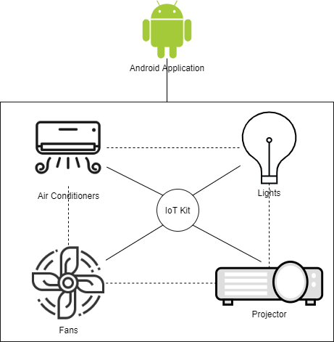
2.1 Existing System.

Slide 14
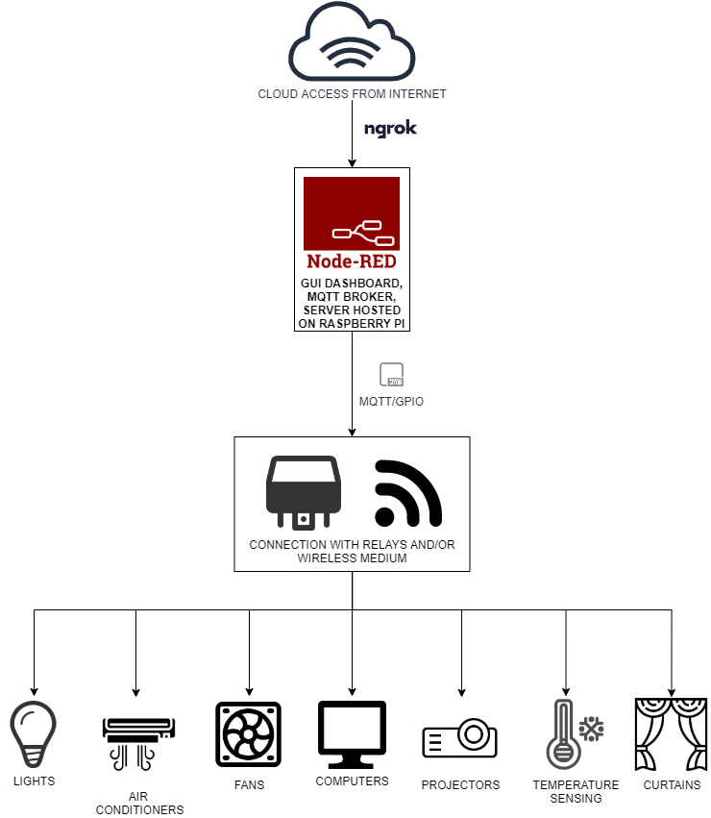
2.2 Proposed System

Slide 15
3. Implementation

Slide 16
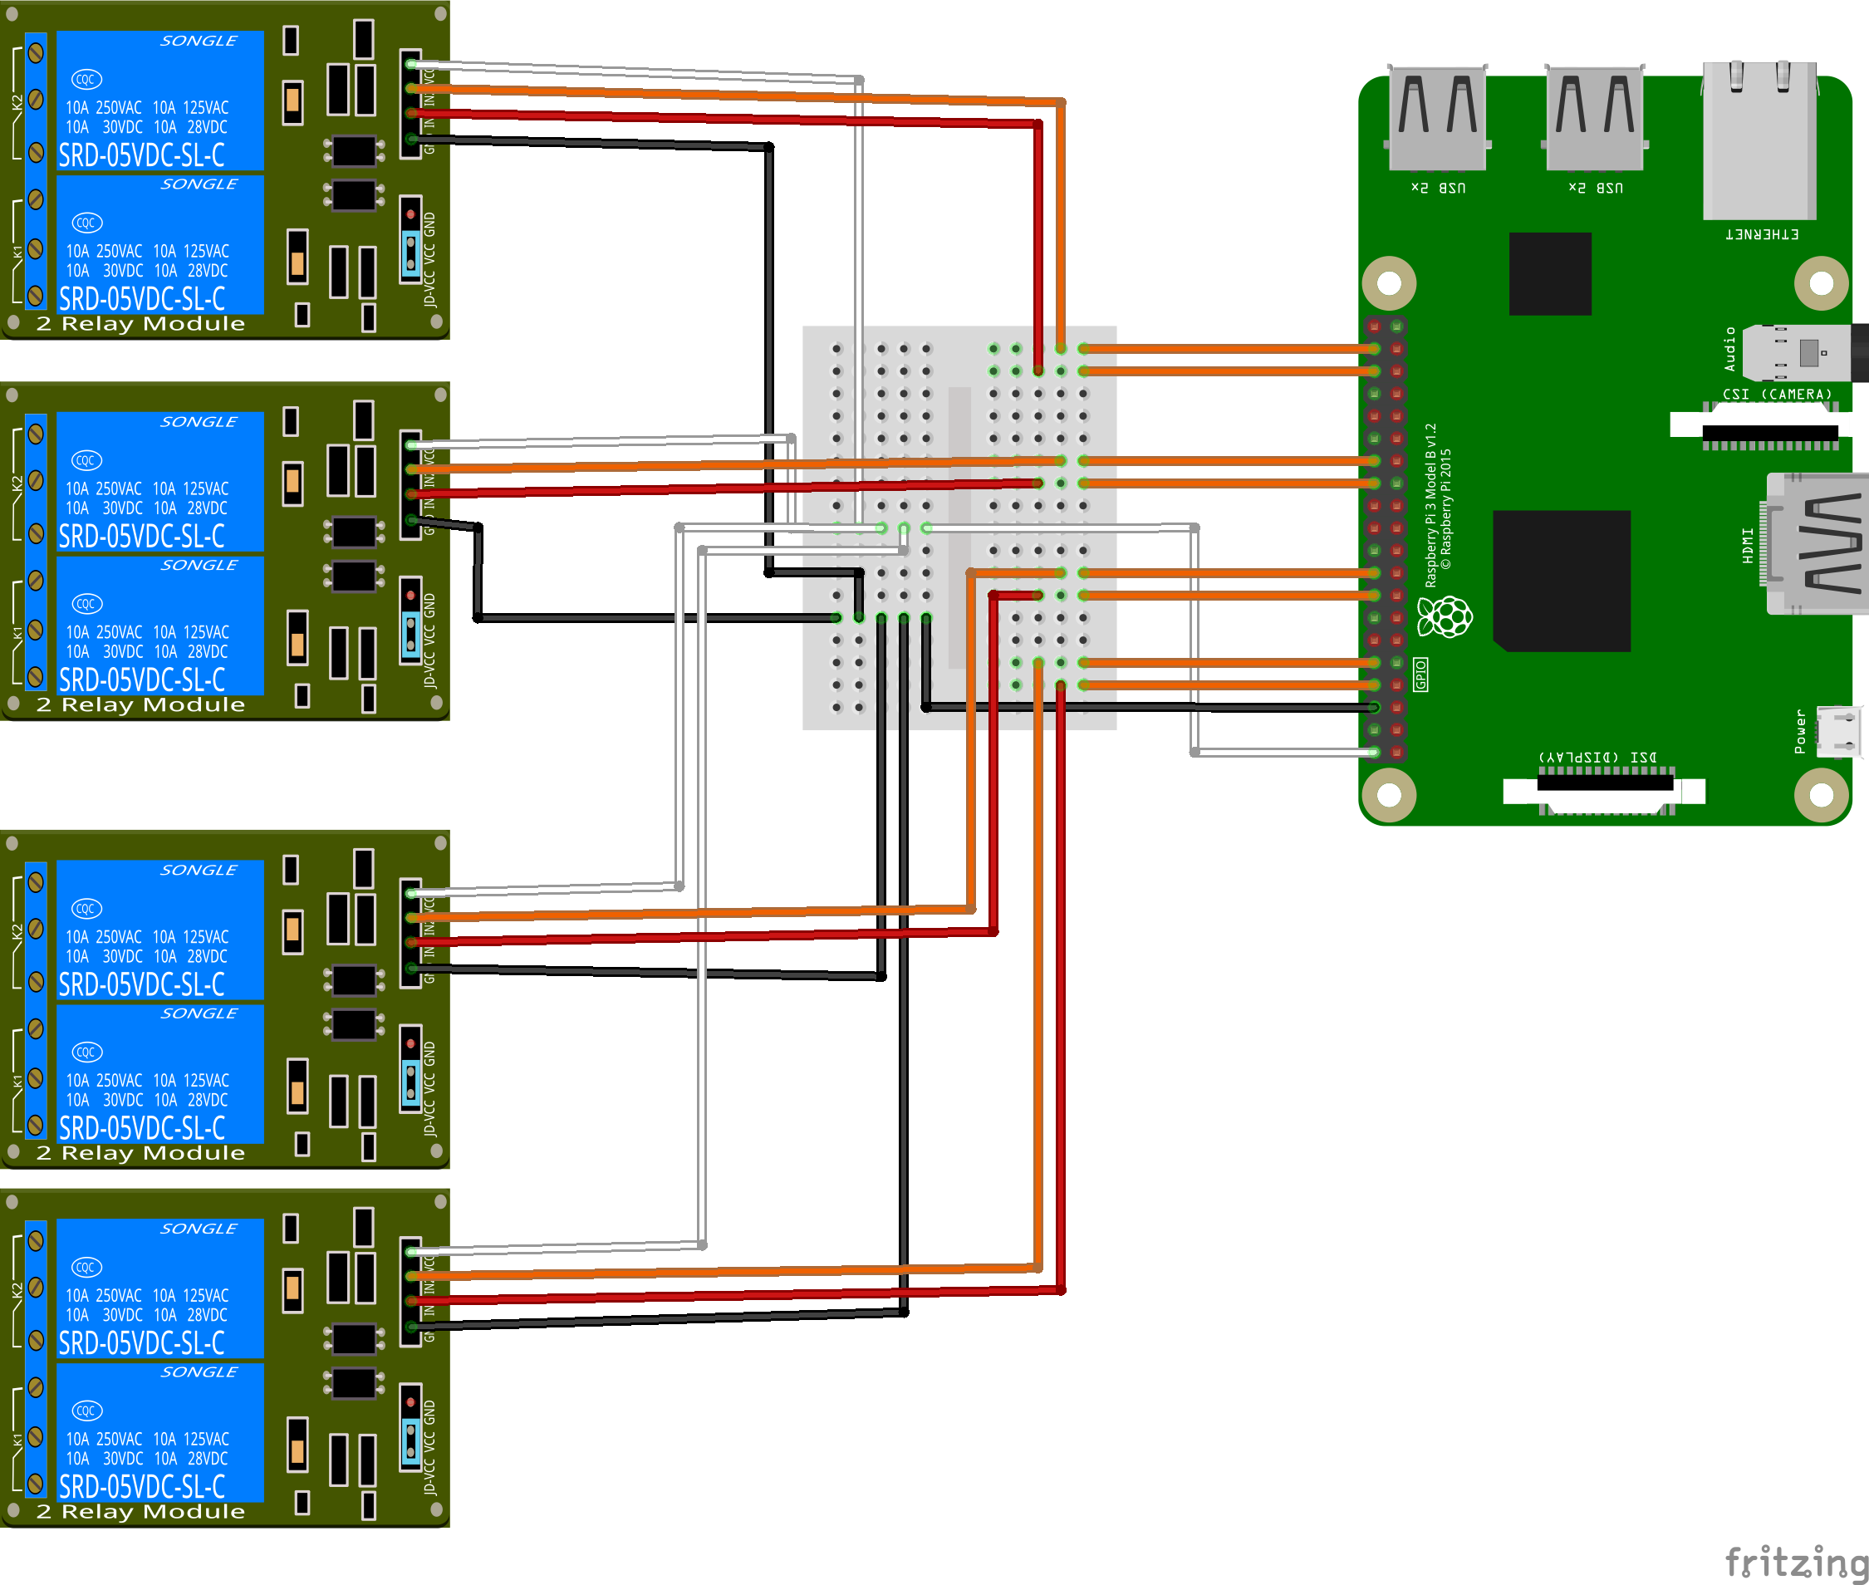
Breadboard Circuit Design:

Slide 17
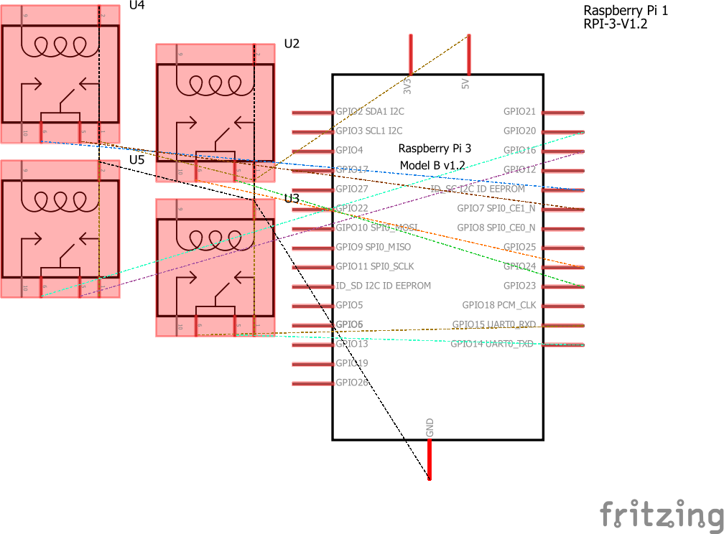
Schematic of the Circuit:

Slide 18
4. Testing

Slide 19
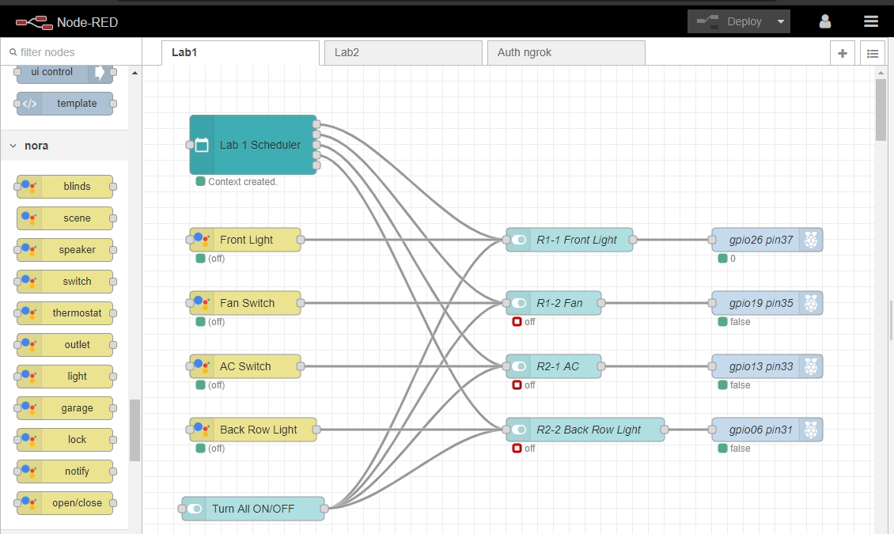
Node-RED Editor:

Slide 20
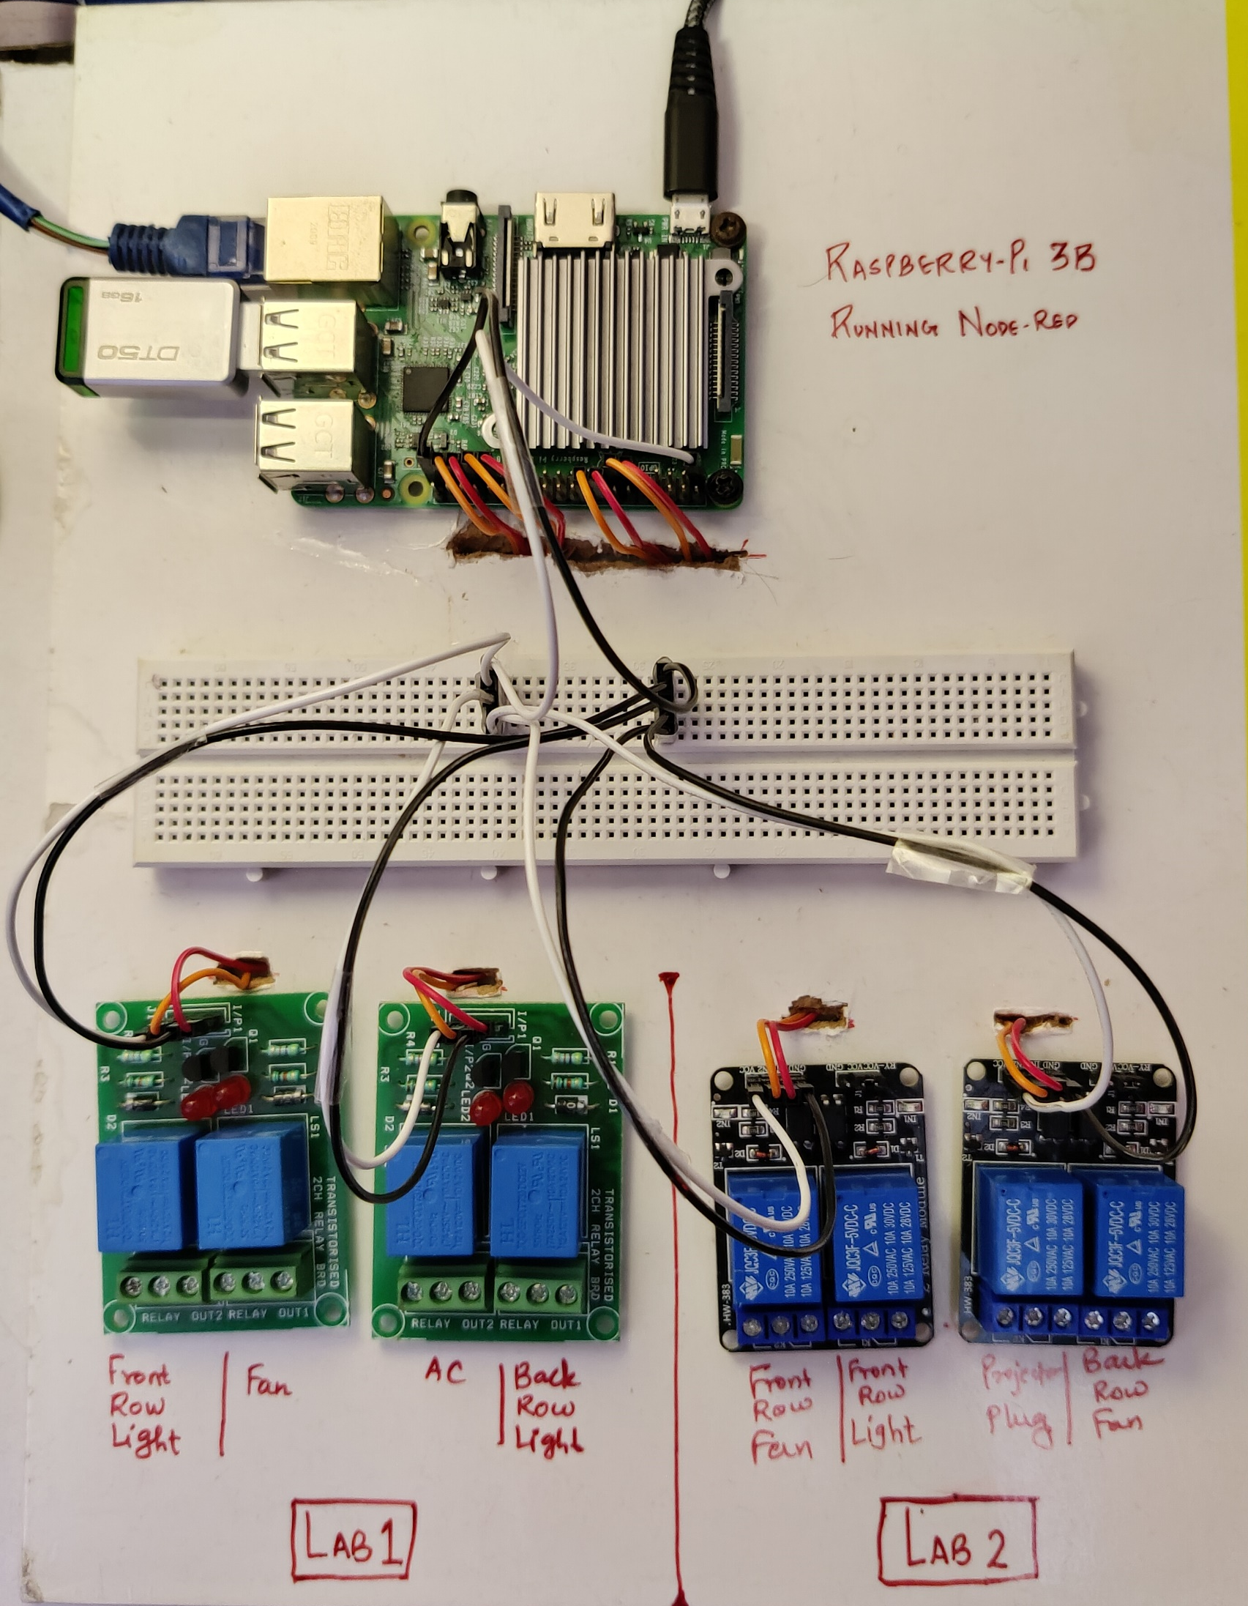
Final Circuit:

Slide 21
5. Result

Slide 22
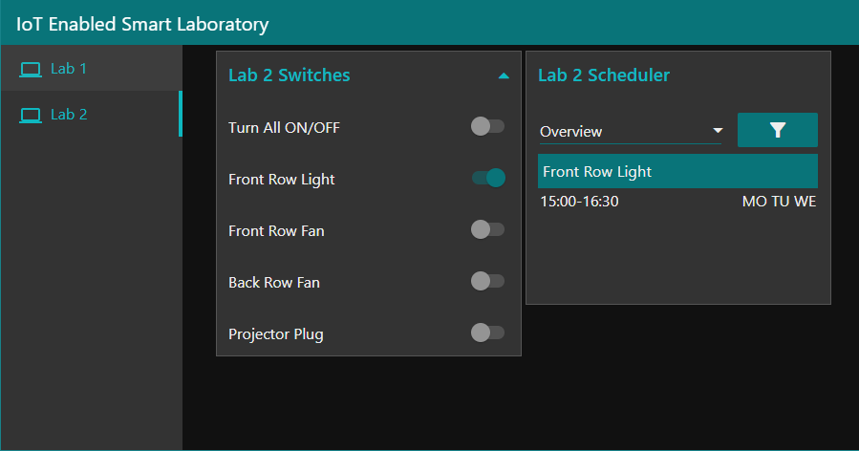
Node-RED GUI Dashboard:

Slide 23
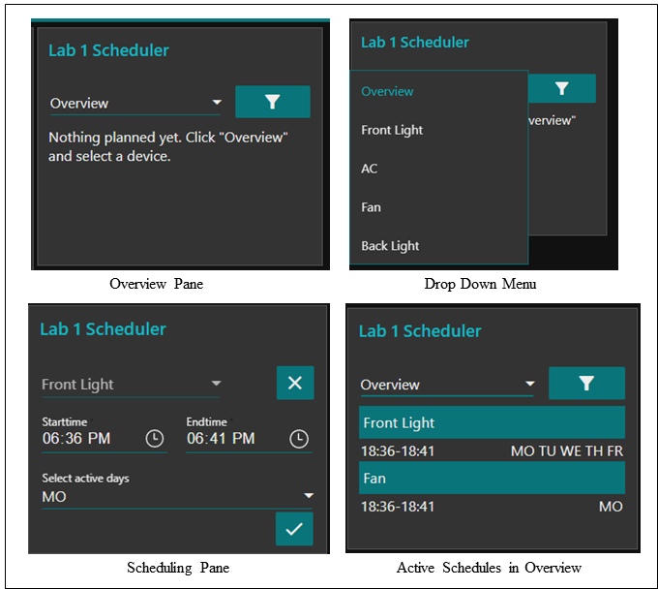
Time Scheduling:

Slide 24
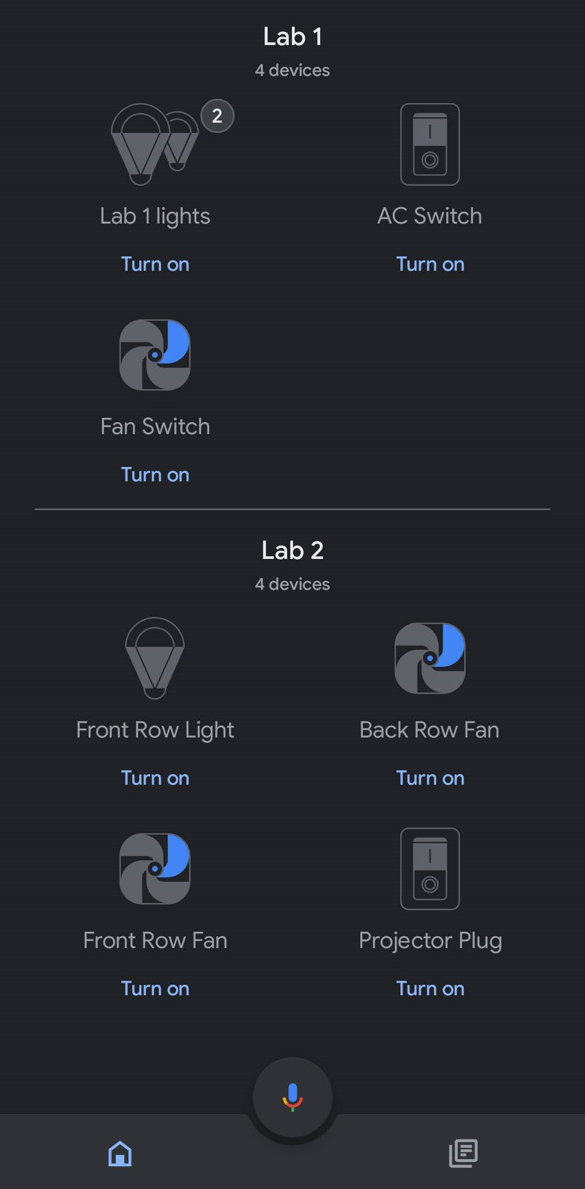
Google Home Integration:

Slide 25
6. Conclusion and Future Scope

Slide 26
Conclusion and Future Scope:
We have listed the problems and proposed a solution to reduce the inconvenience for the research lab assistants and college members to the utmost.
The Node-RED GUI Dashboard is accessible via browser, it ensures cross-platform compatibility.
The Expected system can ease the complete automation method in labs and create the lab management easily.
In Future, we can have a more-refined overall hardware solution, and extend this system for usage in other areas such as homes, studios, industries, shops, offices, etc.

Slide 27
Limitations of this system:
Constant internet connection required for remote access.
The system requires continuous power to be supplied in order to function.
Node-RED only supports BASIC and OAuth Authentication Standards.
Multi-user support is limited to some extent due to Node-RED’s Nature.

Slide 28
References
M. Poongothai, P. M. Subramanian and A. Rajeswari, “Design and implementation of IoT based smart laboratory,” 2018 5th International Conference on Industrial Engineering and Applications (ICIEA), Singapore, 2018, pp. 169-173.
R. K. Kodali and A. Anjum, “IoT Based HOME AUTOMATION Using Node-RED,” 2018 Second International Conference on Green Computing and Internet of Things (ICGCIoT), Bangalore, India, 2018, pp. 386-390.
T. Malche and P. Maheshwary, “Internet of Things (IoT) for building smart home system,” 2017 International Conference on I-SMAC (IoT in Social, Mobile, Analytics and Cloud) (I-SMAC), Palladam, 2017, pp. 65-70.
S. Somani, P. Solunke, S. Oke, P. Medhi and P. P. Laturkar, “IoT Based Smart Security and Home Automation.” 2018 Fourth International Conference on Computing Communication Control and Automation (ICCUBEA), Pune, India, 2018, pp. 1-4.

Slide 29
H. K. Singh, S. Verma, S. Pal and K. Pandey, “ A step towards Home Automation using IOT,” 2019 Twelfth International Confernce on Contemporary Computing (IC3), Noida, India, 2019, pp. 1-5.
Ranjan, Praful. (2017). Home Automation Using IOT. 10.21742/ijsh.2017.11.09.01.
Kumar Selvaperumal, Assoc. Prof. Dr. Sathish and Al-Gumaei, Waleed and Abdulla, Raed and Thiruchelvam, Vinesh. (2019). Integrated Wireless Monitoring System Using LoRa and Node-Red for University Building. Journal of Computational and Theoretical Nanoscience. 16. 3384-3394. 10.1166/jctn.2019.8297.
Sfikas, Giorgos and Akasiadis, Charilaos and Spyrou, Evaggelos. (2016). Creating a Smart Room using an IoT approach.

Slide 30
Publication:
Paper entitled “IoT Enabled Smart Laboratory” is accepted at “ICT4SD 2021 Sixth International Conference on ICT for Sustainable Development” by “Prathmesh Pande”, “Ritesh Shetty”, “Bhavana Kondurkar” and “Prof. Vishal Badgujar”.

Slide 31
Thank You

